Slide 1

Machine Learning project

Slide 2
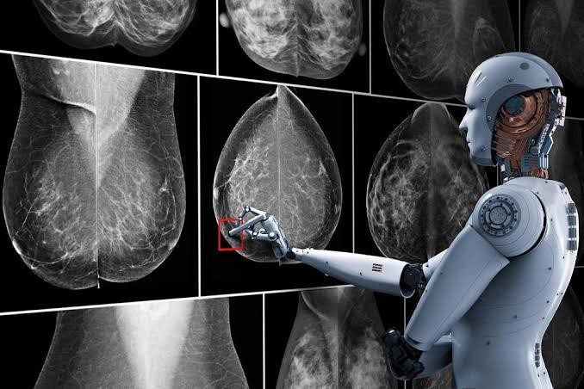
Breast Cancer
Team Names
Ahmed Sameer Afifi
Asmaa Shawky Yoness
Aya shrief Elasmar
Hekmat Gamal Abouelnassr

Slide 3

Introduction
The most common cancer in women worldwide.
The principle cause of death from cancer among women globally.
Early detection is the most effective way to reduce breast cancer deaths.
Early diagnosis requires an accurate and reliable procedure to distinguish between benign breast tumors from malignant ones

Slide 4
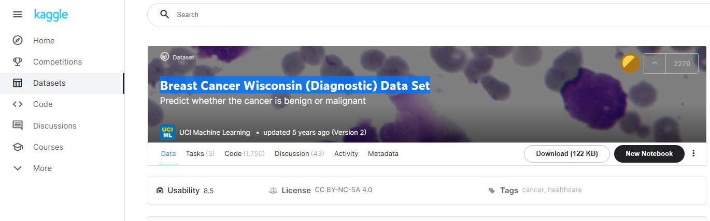
Data Source
Breast Cancer Wisconsin (Diagnostic) Data Set – From Kaggle
https://www.kaggle.com/uciml/breast-cancer-wisconsin-data

Slide 5
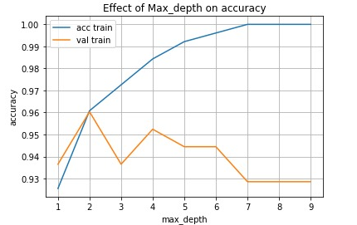
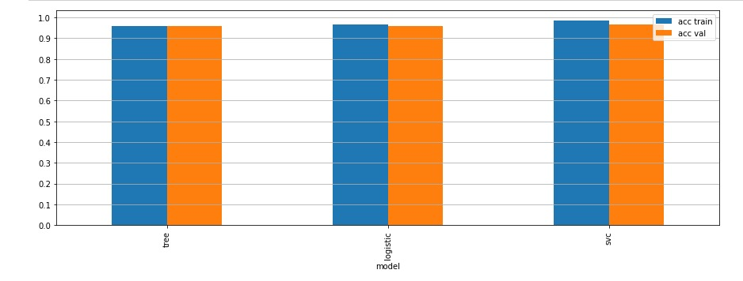
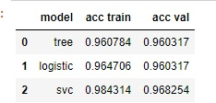
Problem definition
Try to do Classification of Data and choose a model that defines the best result of Breast Cancer data
Input
Data set after preprocessing & other editions
Output

Slide 6
Steps of project
Pre processing
Split data ( Train – Validate – Test )
Feature Scaling
Helper function – Classification
Test

Slide 7
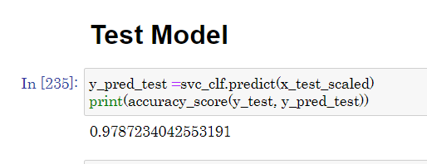
Results

Slide 8

Thank you

